Slide 1
Sudoku Solver
Amir224030 - Amr228074 - Sameh218767

Slide 2
Agenda
Introduction
Project Scope
Literature Review
Algorithms
Backtracking
Genetic
Comparison
Final Product
References

Slide 3
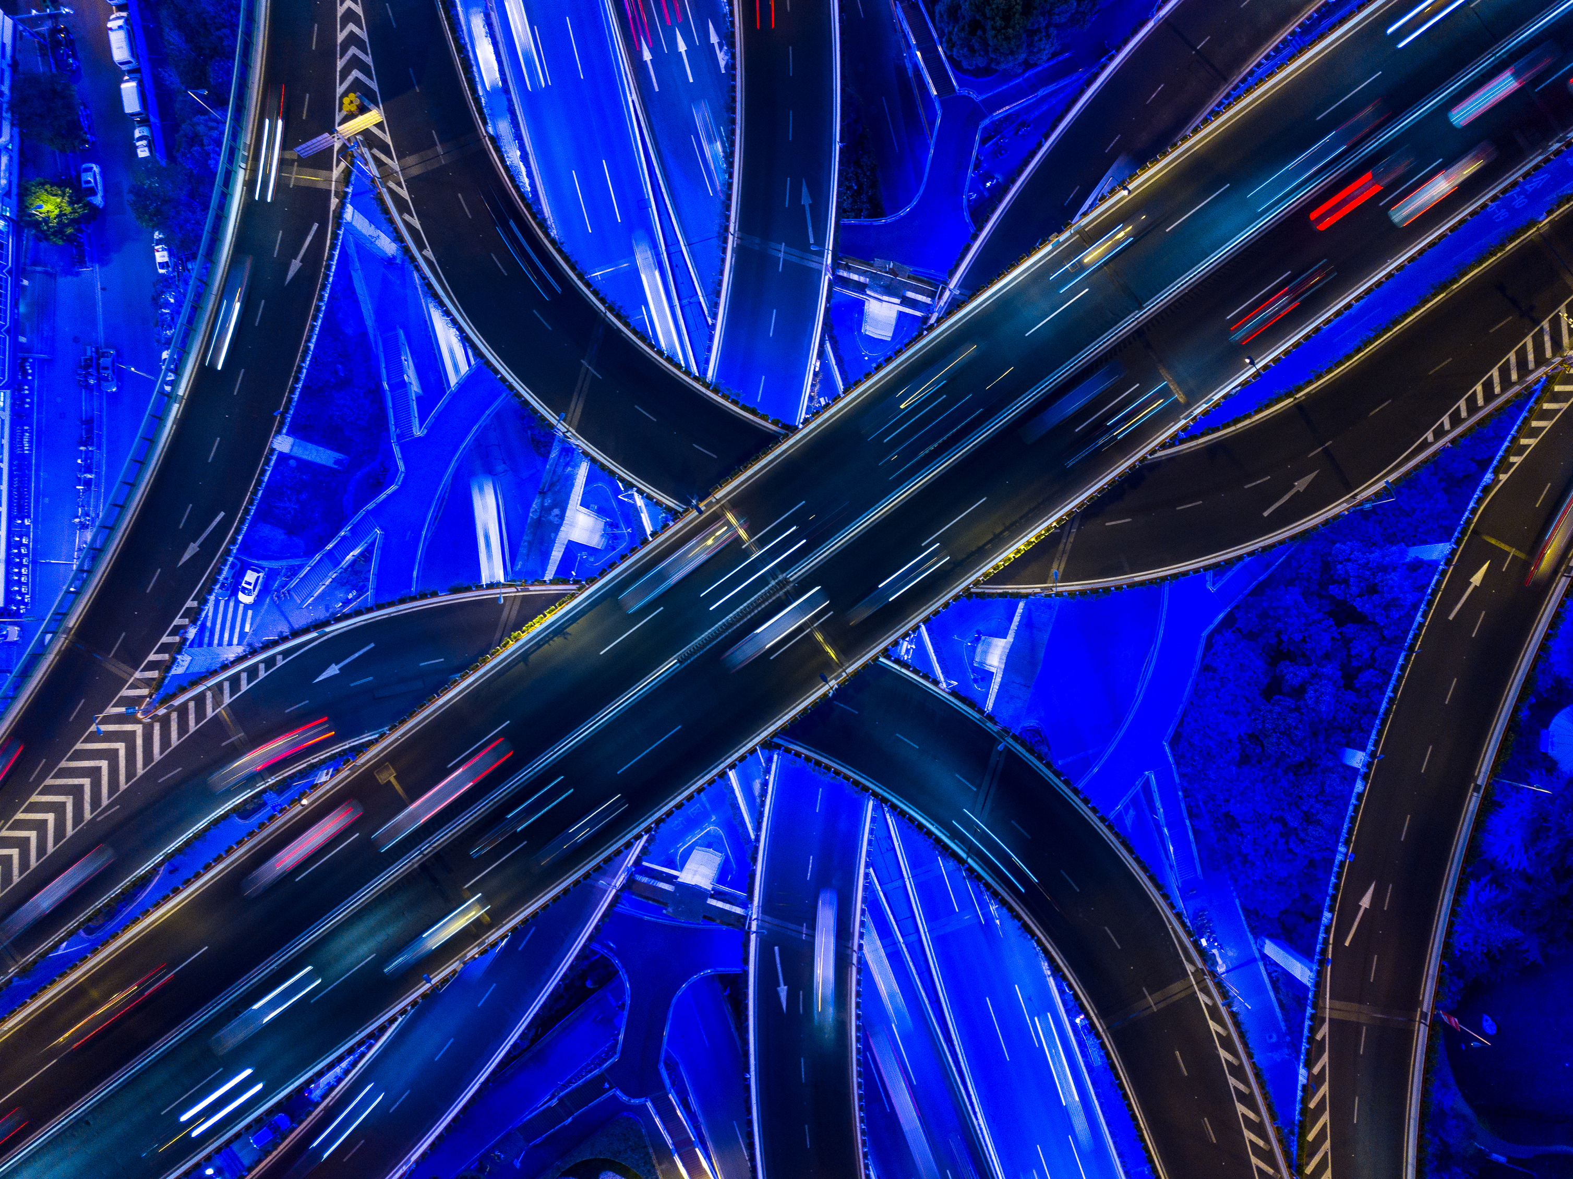
Introduction

Slide 4
Sudoku is a popular logic puzzle that requires filling a 9x9 grid with digits 1-9 such that each row, column, and 3x3 sub-grid contains all the digits without repetition. This project creates a user-friendly application that utilizes two algorithms, backtracking and genetic algorithm, to solve sudoku puzzles of varying difficulties while educating users on the solving process.

Slide 5

Project Scope

Slide 6
Project Scope
Allow users to choose among predefined sudoku puzzles and decide on the size of the overall puzzle.
Allow users to choose between either backtracking or genetics algorithms to solve the puzzle.
Show performance metrics such as speed, steps and iterations needed to reach the right solution.
Display the game in professionally made UI to improve accessibility and mitigate any difficulties that might be faced in the learning process.

Slide 7
Literature Review

Slide 8
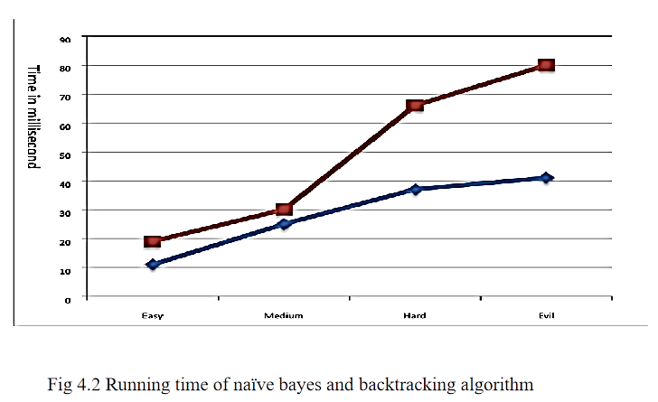
Paper 1: Backtracking vs Genetic Algorithms for Sudoku Solving: A Comparative Analysis
Research Focus: Comparison of Backtracking and Naïve Bayes for solving Sudoku puzzles.
Key Findings:
Backtracking
Highly efficient in terms of time.
Works by exploring potential solutions and stops once the solution is found.
Effective across all difficulty levels of Sudoku.

Slide 9
Paper 2: Human Problem Solving: Sudoku Case Study
Backtracking Algorithm Overview:
Starts with an empty Sudoku grid.
Assigns values sequentially while checking for violations.
Operational Steps:
Begin with an empty assignment.
Select a variable based on the fewest legal values.
Assign a valid value from the variable's domain.
If a constraint is violated, backtrack and reassign.
Continue until all variables are assigned without violation.
Search Strategy:
Utilizes a depth-first search approach.
Efficiently navigates through large search spaces.
Outcome:
Successfully finds solutions by exploring possible assignments.
Iterates until a solution is found or all options are tested.

Slide 10
Paper 3: A Novel Hybrid Genetic Algorithm for Solving Sudoku Puzzles
Algorithm Components:
Genetic Algorithm: Enhanced with specific operators tailored for Sudoku.
Particle Swarm Optimization (PSO): Introduced as part of the hybrid approach.
Key Modifications:
1. Selection Operator: Improved by grouping based on fitness scores to enhance diversity.
2. Crossover Operator: Uses multiple crossover points and bit-shift optimization for directional exchange.
3. Mutation Operator: Swaps two elements within a sub-block to adhere to Sudoku rules.
Fitness Function:
Evaluates the solution based on the absence of duplicate numbers in rows and columns.
Lower scores indicate fewer violations and better solutions.
Encoding Strategy:
Represents Sudoku puzzles with 81 numbers, using zeros for empty cells.
Divided into nine 3x3 sub-blocks for genetic operations.
Objective:
To increase the effectiveness and efficiency of solving Sudoku puzzles using a hybrid genetic approach.

Slide 11
Paper 4: A study of Sudoku Solving Algorithms
Thesis Focus: Evaluates three algorithms for solving Sudoku puzzles: backtrack, rule-based, and Boltzmann machines.
Algorithm Overview:
Backtrack: Brute-force with guaranteed solutions, but time-intensive.
Rule-Based: Uses logical rules from human strategies; effective but may require guessing.
Boltzmann Machine: Stochastic neural network approach; variable performance, less effective on hard puzzles.
Performance Insights: Deterministic methods (backtrack, rule-based) are more consistent and superior to the Boltzmann machine in solving complex puzzles.
Additional Research Areas:
Puzzle difficulty rating.
Puzzle generation.
Parallelization potential.
Objective: Compare effectiveness, draw insights on Sudoku solving methods.

Slide 12
Paper 5: Genetic Algorithms and Sudoku
Thesis Focus: Effectiveness of Genetic Algorithms (GAs) in solving Sudoku puzzles.
Context:
Traditional backtracking excels with 9x9 grids but falters on larger grids due to NP-completeness.
GAs, inspired by biological processes, were tested for potential effectiveness.
Implementation Details:
Programming: Implemented in C++.
Solution Encoding: Permutations of digits within subgrids.
Fitness Function: Counts duplicate digits in rows and columns.
Genetic Operators: Custom crossover and mutation tailored to Sudoku.
Optimization: Restarts with new populations from best solutions when stuck.
Performance Observations:
Disappointing results, often stuck in local optima.
Required multiple restarts, results varied with parameter adjustments.
Conclusions:
Sudoku may pose challenges for GAs due to discrete solution space and prevalent local optima.
Suggests exploring finer-grained fitness functions for potential improvements.
Objective: Assess GA's capability to solve Sudoku and explore reasons for performance limitations.

Slide 13
Algorithms
Backtracking & Genetic algorithms

Slide 14
Backtracking Algorithm
Efficient and systematic method for solving well-defined problems like Sudoku and works by exploring all possible solutions and backtracks if a solution violates the rules which makes it well-suited for constraint satisfaction problems like Sudoku. However, may become computationally expensive for highly complex puzzles [1] [2] [4].

Slide 15
Backtracking Algorithm
Strengths:
Guaranteed to find a solution if one exists.
Fast and efficient for most Sudoku puzzles, especially smaller grids.
Easy to implement.
Weaknesses:
May become computationally expensive for highly complex puzzles (exponential time complexity in worst-case scenarios).
Not ideal for problems with many equally valid solutions.
Backtracking is a powerful technique for solving Sudoku puzzles. It guarantees a solution if one exists, is efficient for most puzzles and is relatively simple to implement. However, for highly complex puzzles, backtracking can become computationally expensive [1] [2] [4].

Slide 16
Backtracking Algorithm
Implementation [1] :
Find an empty square.
Try placing digits 1 to 9 in that square.
Check if the placed digit is valid according to the Sudoku rules.
If the digit is valid, recursively try to fill the remaining board using steps 1-3.
If the digit is invalid, go back to the previous step and try a different digit in the same square.
If all squares are filled with valid assignments and no constraints are violated, a solution is found.
If all possibilities for the current square have been explored and no valid assignment exists, backtrack to the previous square and repeat.

Slide 17
Genetic Algorithm
Find optimal solution by mimicking natural selection and exploring a wider range of solutions and may find unique solutions backtracking might miss as it works by iteratively evolving solutions through selection, crossover, and mutation operators. It is effective for optimization problems and situations with a poorly defined search space. However, it requires more iterations to converge on an answer compared to backtracking and can be computationally expensive [1] [3] [5].

Slide 18
Genetic Algorithm
Strengths:
Can explore a wider range of solutions compared to backtracking, potentially finding unique solutions.
May be suitable for larger grid sizes where backtracking becomes less efficient.
Weaknesses:
GA often stalls in local optima, requiring frequent restarts.
Adjusting GA population size showed unpredictable effects, leading to inconsistent performance.
Research suggests that Backtracking remains a more efficient and reliable approach for solving Sudoku puzzles compared to Genetic Algorithms [1] [3] [5].

Slide 19
Comparison

Slide 20
Comparison
Backtracking is generally faster and more memory-efficient than the Genetic Algorithm, especially for easy and medium difficulty puzzles.
Backtracking is more reliable in finding a solution, while the Genetic Algorithm may struggle with complex puzzles.
The Genetic Algorithm may require adjusting the population size to balance exploration and exploitation for better performance.

Slide 21
Final Product

Slide 22
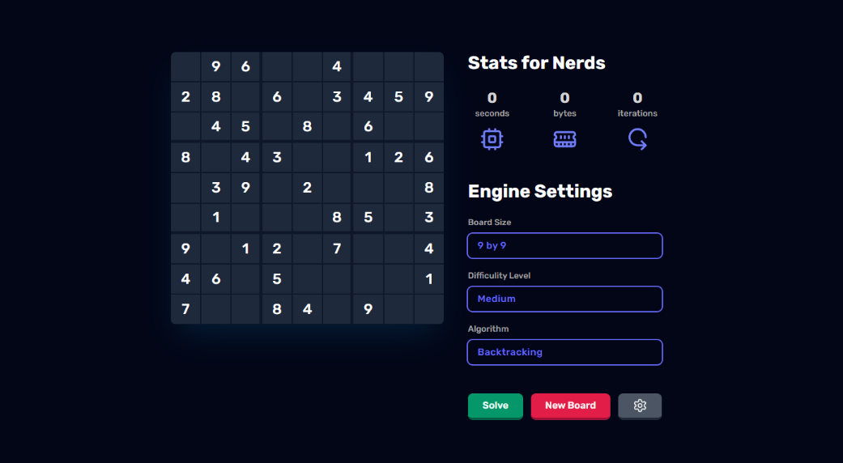
Final Product

Slide 23





Final Product
User-friendly interface to generate boards of different sizes (4x4, 6x6, 9x9)
Shows performance metrics (time, memory, iterations) for each algorithm.
Various difficulty levels to choose from (easy, medium, hard, very hard).
Option to choose between Backtracking and Genetic Algorithm for solving.

Slide 24
References
[1] T. Navya, T. J. Mounika, S. Tharun, K. R, H. S, and B. A, “Comparative study on Sudoku using Backtracking algorithm,” First International Conference on Smart Systems and Green Energy Technologies, 2023, doi: https://doi.org/10.13052/rp-9788770229647.032.
[2] R. Pelánek, “Human Problem Solving: Sudoku Case Study,” 2011. Accessed: Mar. 27, 2024. [Online]. Available: https://www.fi.muni.cz/reports/files/2011/FIMU-RS-2011-01.pdf
[3] X. Q. Deng and Y. D. Li, “A novel hybrid genetic algorithm for solving Sudoku puzzles,” Optimization Letters, vol. 7, no. 2, pp. 241–257, Oct. 2011, doi: https://doi.org/10.1007/s11590-011-0413-0.
[4] P. BERGGREN and D. NILSSON, “A study of Sudoku solving algorithms” thesis, 2012. https://www.csc.kth.se/utbildning/kandidatexjobb/datateknik/2012/rapport/berggren_patrik_OCH_nilsson_david_K12011.pdf
[5] J. M. Weiss, “Genetic Algorithms and Sudoku” thesis, 2009. https://micsymposium.org/mics_2009_proceedings/mics2009_submission_66.pdf

Slide 25
THANK YOU for your time

